Slide 1
電腦視覺與深度學習 (Computer Vision and Deep Learning) Homework 1
TA:
Mark : 29A7882zz@gmail.com
Office Hour: 09:00~11:00, Wed.
19:00~21:00, Mon.
At CSIE 9F Robotics Lab.

Slide 2
Notices (1/2)
Copying homework is strictly prohibited!! Penalty: Grade will be zero for both persons!!
If the code can’t run, you can come to our Lab within one week and show that your programming can work. Otherwise you will get zero!!
Due date => 2019/11/06 (Wed.) 23:59:59
No delay. If you submit homework after deadline, you will get 0.
Upload to => 140.116.154.1 -> Upload/Homework/HW1
User ID: cvdl2019 Password: cvdl2019
Format
Filename: Hw1_StudentID_Name_Version.rar
Ex: Hw1_F71234567_林小明_v1.rar
If you want to update your file, you should update your version to be v2, ex: Hw1_F71234567_林小明_v2.rar
Content: project folder*( including the pictures ) *note: remove your “Debug” folder to reduce file size

Slide 3
Notices (2/2)
C++ (check MFC guide in ftp)
OpenCV 3.3.1 (https://opencv.org/release.html)
Visual Studio 2015 (download from http://www.cc.ncku.edu.tw/download/)
UI framework: MFC
Python
Python 3.7 (https://www.python.org/downloads/)
Tensorflow 2.0 / PyTorch 1.3.0
opencv-contrib-python (3.4.2.17)
Matplotlib 3.1.1
UI framework: pyqt5 (5.11.3)

Slide 4
Grading
0. Homework Format
1. (10%, reference) Camera Calibration (出題：Jang)
1.1 Corner detection (0%)
1.2 Find the intrinsic matrix (0%)
1.3 Find the extrinsic matrix (0%)
1.4 Find the distortion matrix (0%)
2. (20%) Augmented Reality (出題：Jang)
3. (10%, reference) Image Transformation (出題：YiYuan)
3.1 Rotation, scaling, translation (0%)
3.2 Perspective transform (0%)
4. (10%, reference) Find Contour (出題：Rex)
5. (50%) Training Cifar-10 classifier using LeNet (出題：Michael)

Slide 5
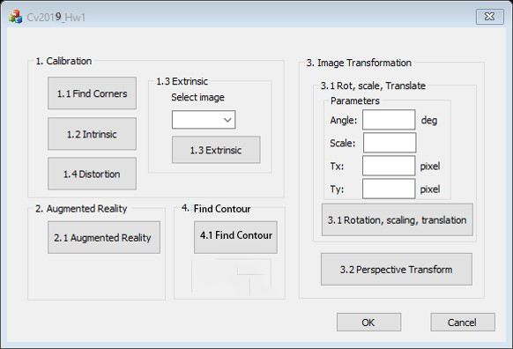
0. Homework Format
Use MFC to create GUI like following picture

Slide 6
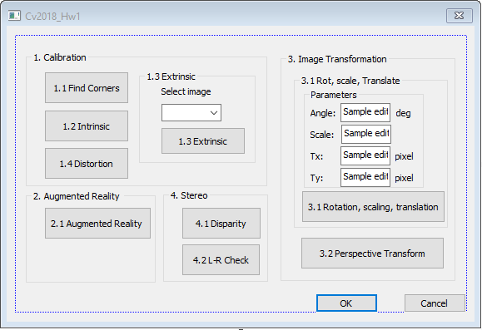
1. Camera Calibration (出題：Jang)
1.1 Corner detection
1.2 Find the intrinsic matrix
1.3 Find the extrinsic matrix
1.4 Find the distortion matrix

Slide 7
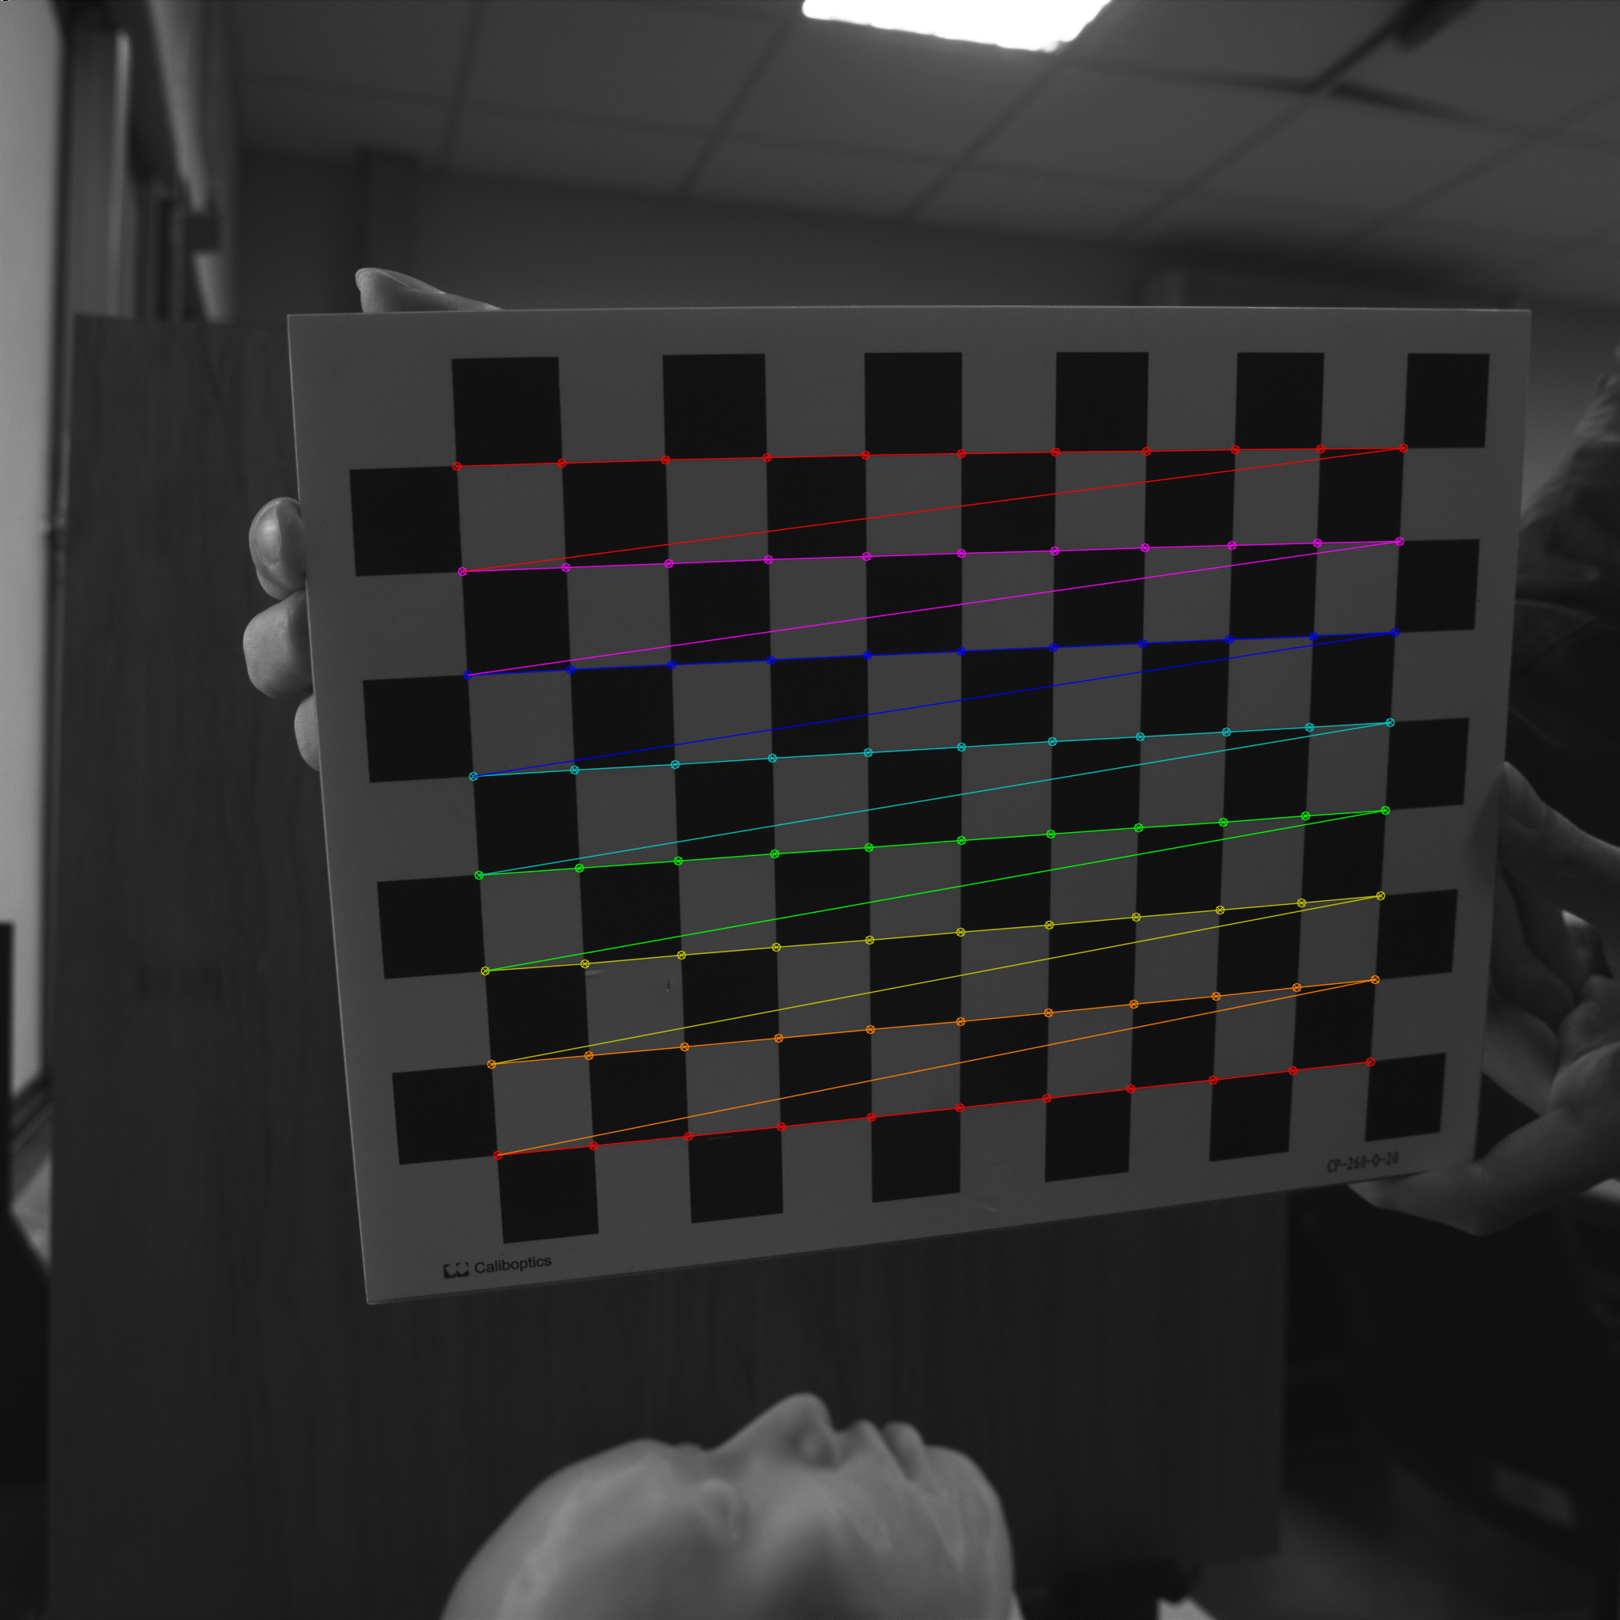
1.1 Corner Detection
Given: 15 images, 1.bmp ~ 15.bmp
Q: 1) Find and draw the corners on the chessboard for each image.
2) Click button “1.1” to show the result.
Hint :
OpenCV Textbook Chapter 11 (p. 398 ~ p. 399)
cvShowImage(…);
Ex:
7

Slide 8
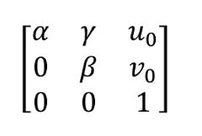
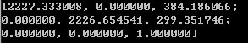
1.2 Find the Intrinsic Matrix
Given: 15 images, 1.bmp ~ 15.bmp
Q: 1) Find the intrinsic matrix ():
2) Click button “1.2” and then show the result on the console window.
Output format:
Hint: OpenCV Textbook Chapter 11 (P.398 ~ p.400)
(Just an example)

Slide 9
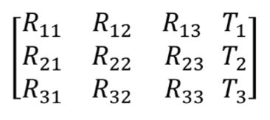
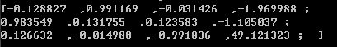
1.3 Find the Extrinsic Matrix
Given: intrinsic parameters, distortion coefficients, and the list of 15 images
Q: 1) Find the extrinsic matrix of the chessboard for each of the 15 images, respectively:
2) Click button “1.3” and then show the result on the console window.
Output format:
Hint: OpenCV Textbook Chapter 11, p.370~402
(Just an example)
(1) List of numbers: 1~15
(2) Select 1, then 1.bmp will be applied, and so on

Slide 10
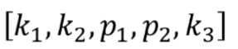
1.4 Find the Distortion Matrix
Given: 15 images
Q: 1) Find the distortion matrix:
2) Click button “1.4” to show the result on the console window.
Output format:
Hint:
Distortion coefficients can be obtained simultaneously with intrinsic parameters
OpenCV Textbook Chapter 11 (P.398 ~ p.400)
(Just
an example)

Slide 11
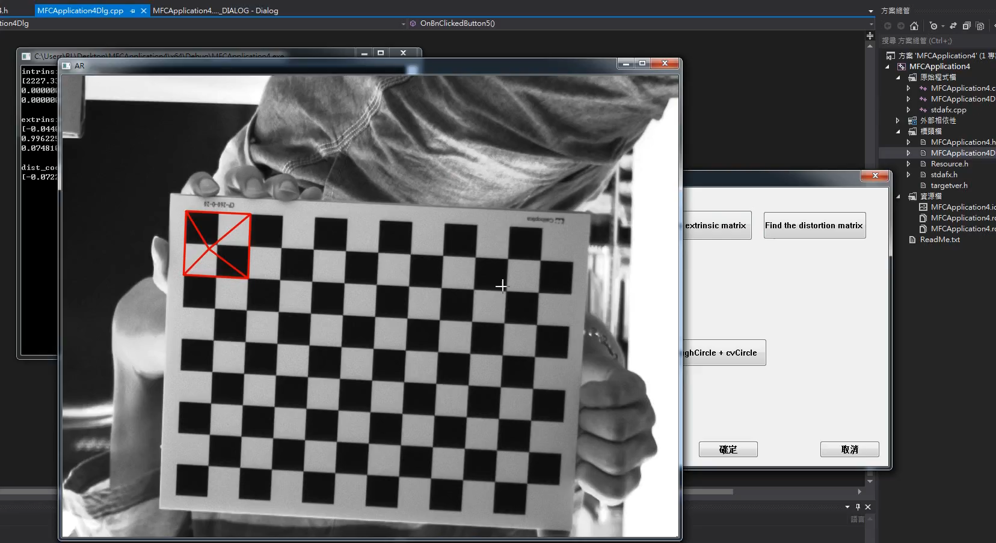
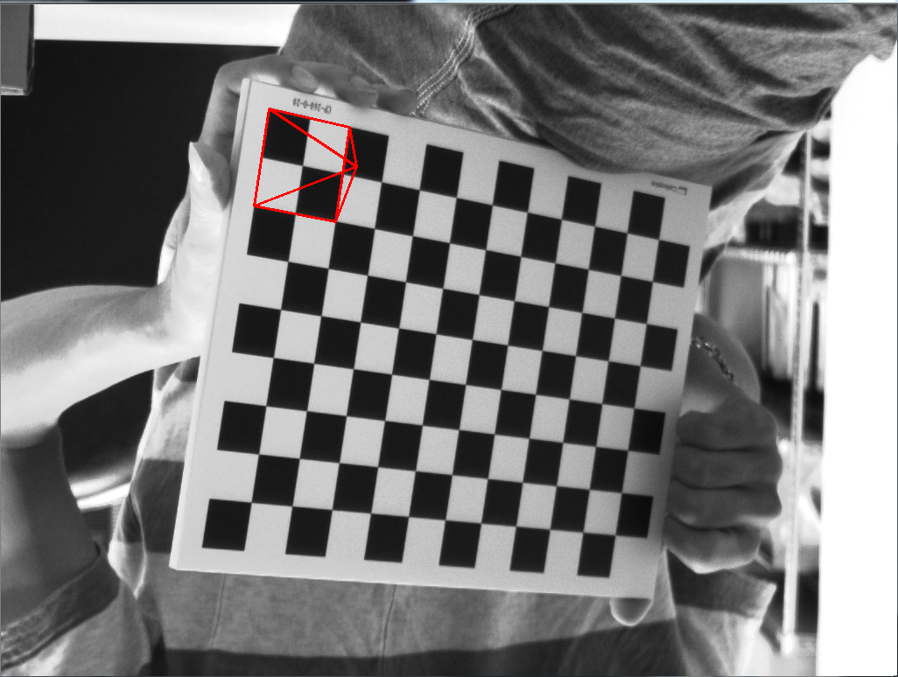
2. Augmented Reality (出題：Jang)
Given: Intrinsic and extrinsic parameters, distortion coefficients, and 5 images: 1~5.bmp
Q: 1) Draw a “pyramid” on the chessboard images (1.bmp to 5.bmp), then
2) Click the button ”2” to show the pyramid on the picture. Show each
picture for 0.5 seconds (total 5 images)
Hint : Textbook Chapter 11, p.370~402
3D Object coordinates:
Vertex (0, 0, -2)
Corners(1, 1, 0)(1, -1, 0)(-1, -1, 0)(-1, 1, 0)
Demo video:
(0,0,0)
(0, 0, -2)
(-1, -1, 0)
(1, -1, 0)
(-1, 1, 0)
(1, 1, 0)
11

Slide 12
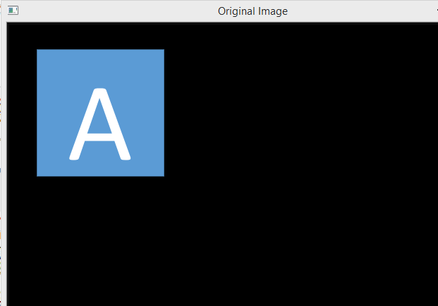
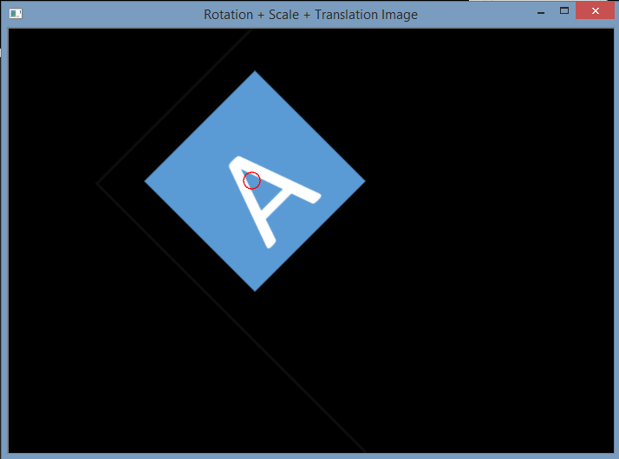
3.1 Transforms: Rotation, Scaling, Translation (出題：YiYuan) ??
Given: OriginalTransform.png image
Q: 1) Click button “3.1”, OriginalTransform.png should be showed.
2) Please rotate, scale and translate the small squared image (as Figure 3.1) with following parameters (should be entered in the GUI):
(1) Angle = 45⁰ (counter-clockwise)
(2) Scale = 0.8,
(3) Translation with:
x_{new} = x_{old} + 150 pixels = 130 + 150 = 280
y_{new} = y_{old} + 50 pixels = 125 + 50 = 175
Point C (130,125) is center of small square image
Hint :
OpenCV Textbook Chapter 12 (p. 407 ~ p. 412)
warpAffine(…);
EX:
Small square image
C (130,125)
C (280,175)
45⁰
Figure 3.1 Original Image
Figure 3.2 Rotation, Scale and Translation Image

Slide 13
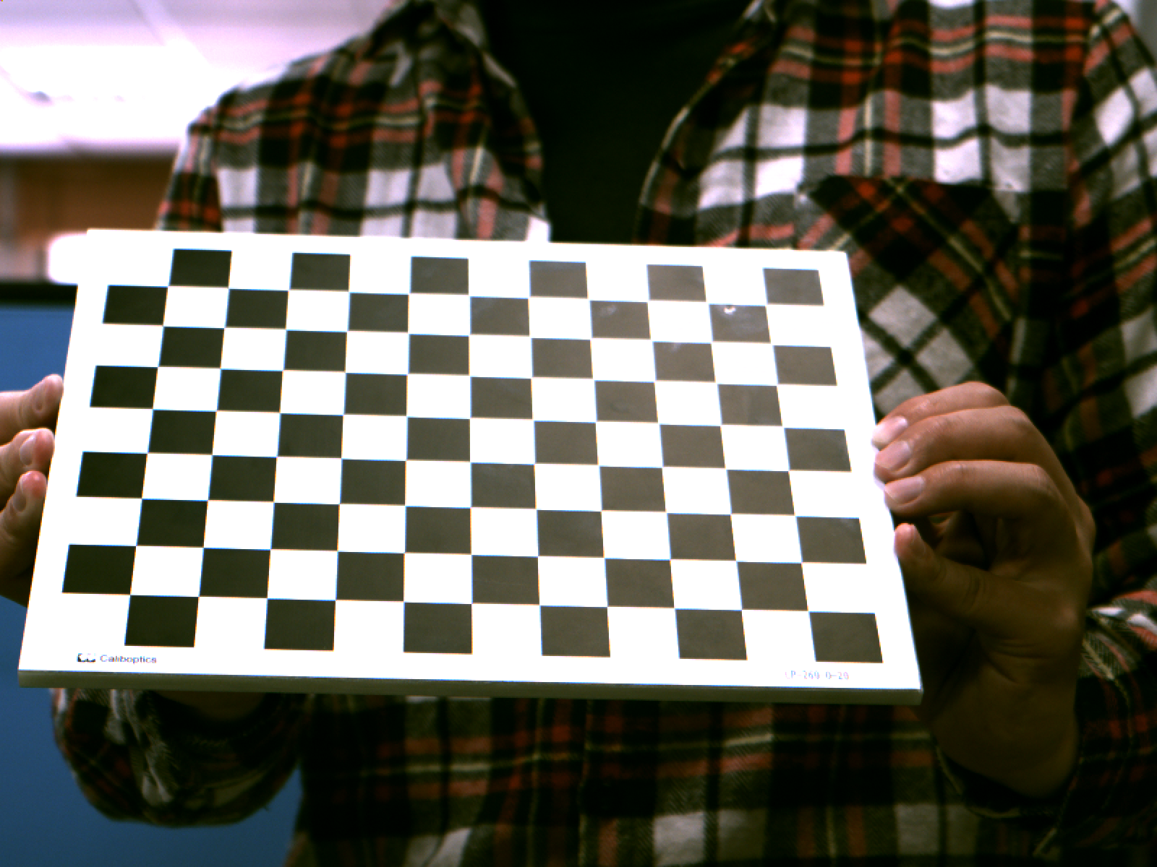
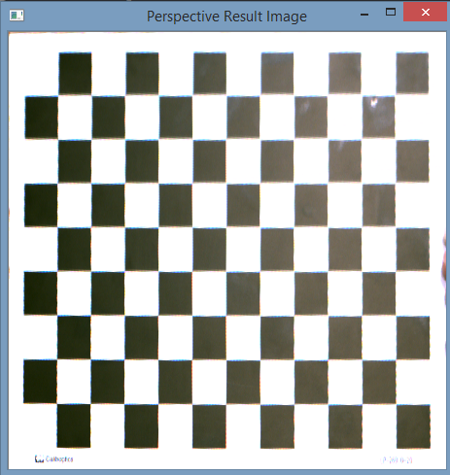
3.2 Perspective Transformation (出題：YiYuan)
Given: OriginalPerspective.png image
Q: Use OpenCV functions to project the image
1) Click button “3.2” to show image in the new window. Then do:
Click 4 points showed in console window. (start from top-left corner of the original image, and then click clock-wise)
Warp the original image to the location (20,20), (20,450), (450,450), (450,20). Open second window to show the result.
Hint:
Textbook Chapter 6, p. 170~171
mouse callback function (p.96)
(20,20)
(450,20)
(20,20)
y
1
2
x
4
3
Original Perspective
(20,450)
Perspective Image
(450,450)

Slide 14
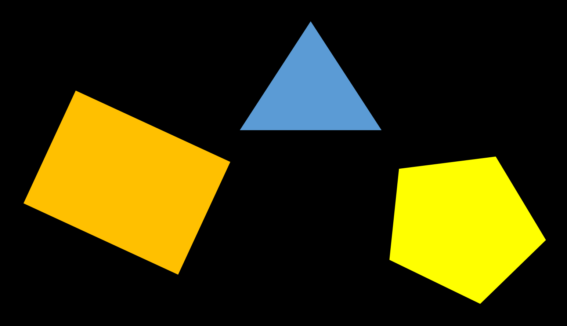
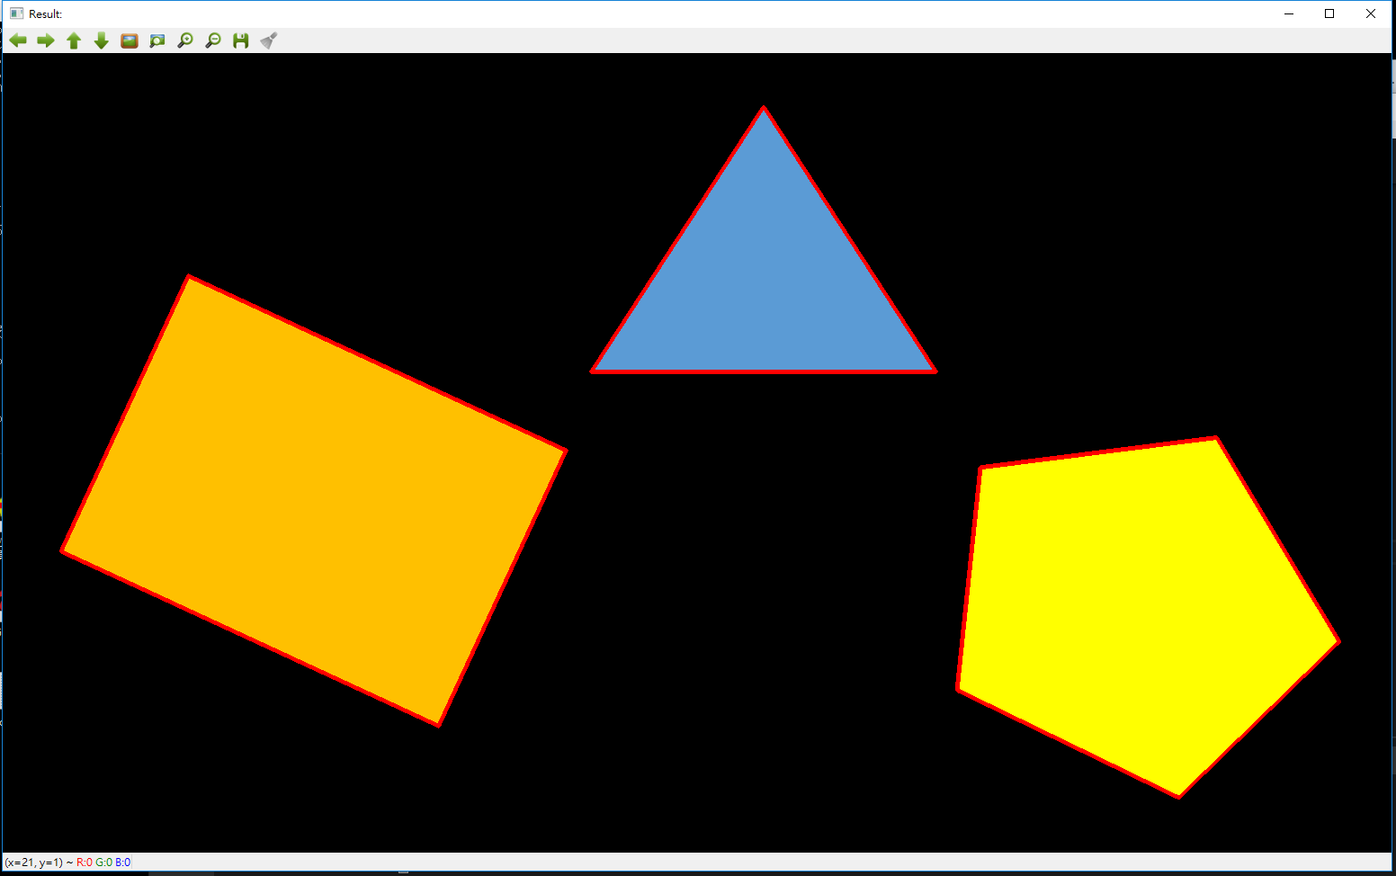
4.0 Find Contour (出題：Rex)
Given: Contour.png image
Q: Use OpenCV functions to find all the contours in the image
1) Click button “4.1” to show image in the new window. Then draw the edges by red.
Hint:
Textbook Chapter 8, p. 234~241

Slide 15
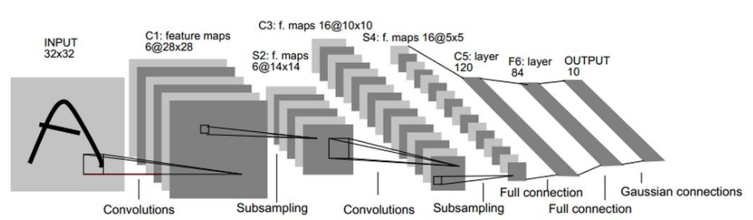
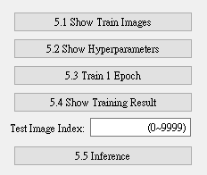
5.0 Train Cifar-10 Classifier Using LeNet-5 (出題：Michael)
Learn to construct LeNet-5 and train it by using data Cifar-10.
Environment Requirement
Python 3.7
Tensorflow 2.0 / PyTorch 1.3.0
opencv-contrib-python 3.4.2.17
Matplotlib 3.1.1
Reference
Gradient-Based Learning Applied to Document Recognition (http://yann.lecun.com/exdb/publis/pdf/lecun-01a.pdf) (LeNet)
Cifar-10 (https://www.cs.toronto.edu/~kriz/cifar.html)

Slide 16
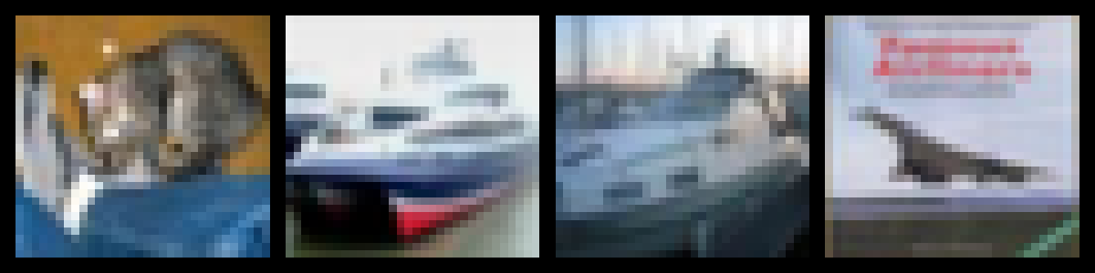
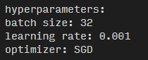
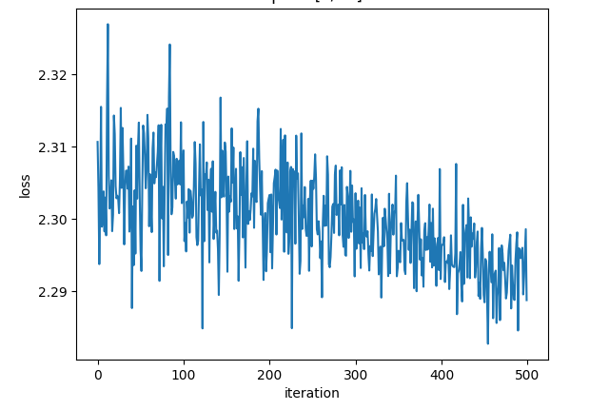
5.1 Load Cifar-10 training dataset and randomly show 10 images and labels respectively. (10%)
5.2 Print out training hyperparameters (batch size, learning rate, optimizer). (10%)
5.3 Train 1 epoch from initial status and show training loss at the end of the epoch. (10%)
…
Label: cat ship ship airplane …
(Record loss per iteration)

Slide 17
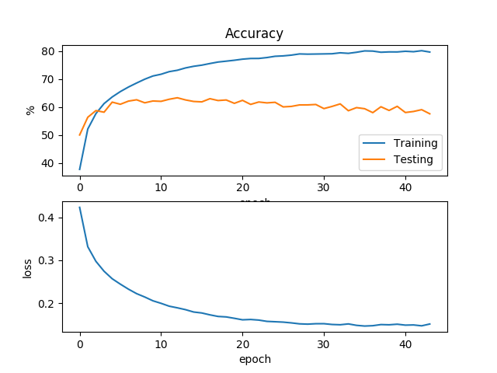
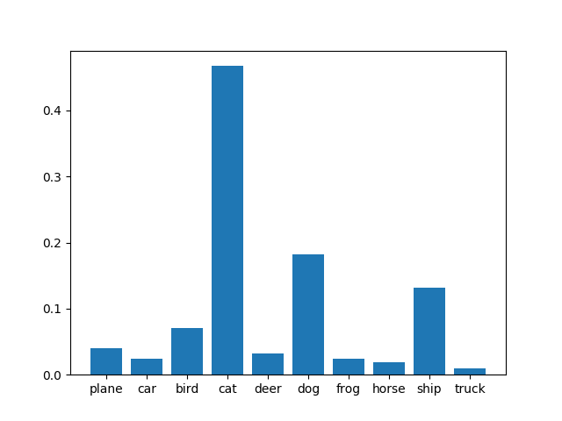
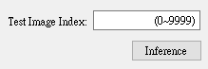
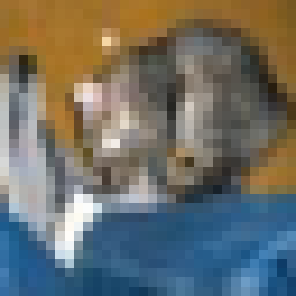
5.4 Train your model at least 50 epochs by your own computer, save your model and take a screenshot of your training loss and accuracy. (10%)
5.5 Load your model trained at 5.4. Let us choose one test image from Cifar-10 test images. Then inference the image, show image and estimate this test image. (10%)
(Record accuracy/loss per epoch)
Show image
Estimation result

